Slide 1
Craigslist Website Redesign
Project Presentation (CS 428+828)
Dhvanil Patel (200370415)
Tushar Borchate (200393116)
Nilay Jha (200409935)

Slide 2
Index
-> What is Craigslists?
-> Opportunities to redesign.
-> Lo-Fi Prototypes and metaphors.
-> Usability testing and feedbacks regarding Lo-Fi prototype.
-> How we will proceed towards Hi-Fi prototype.

Slide 3
What is Craigslists?
-> Craigslist, a well-known classified advertisements website, emerged in 1995 by Craig Newmark (hence the name Craigslist).
-> Craig Newmark began the service in 1995 as an email distribution list to friends, featuring local events in the San Francisco Bay Area.
-> Now it is a famous American classified advertisements website with sections devoted to jobs, housing, for sale, items wanted, services, community, gigs, resumes, and discussion forums.

Slide 4
Opportunities to redesign
→ Content display is cluttered and confusing:
There’s so much content on Craigslist, with hundreds of different local communities and lots of different categories of classifieds. This creates unnecessary clutter which may leave an inexperienced user confused.

Slide 5
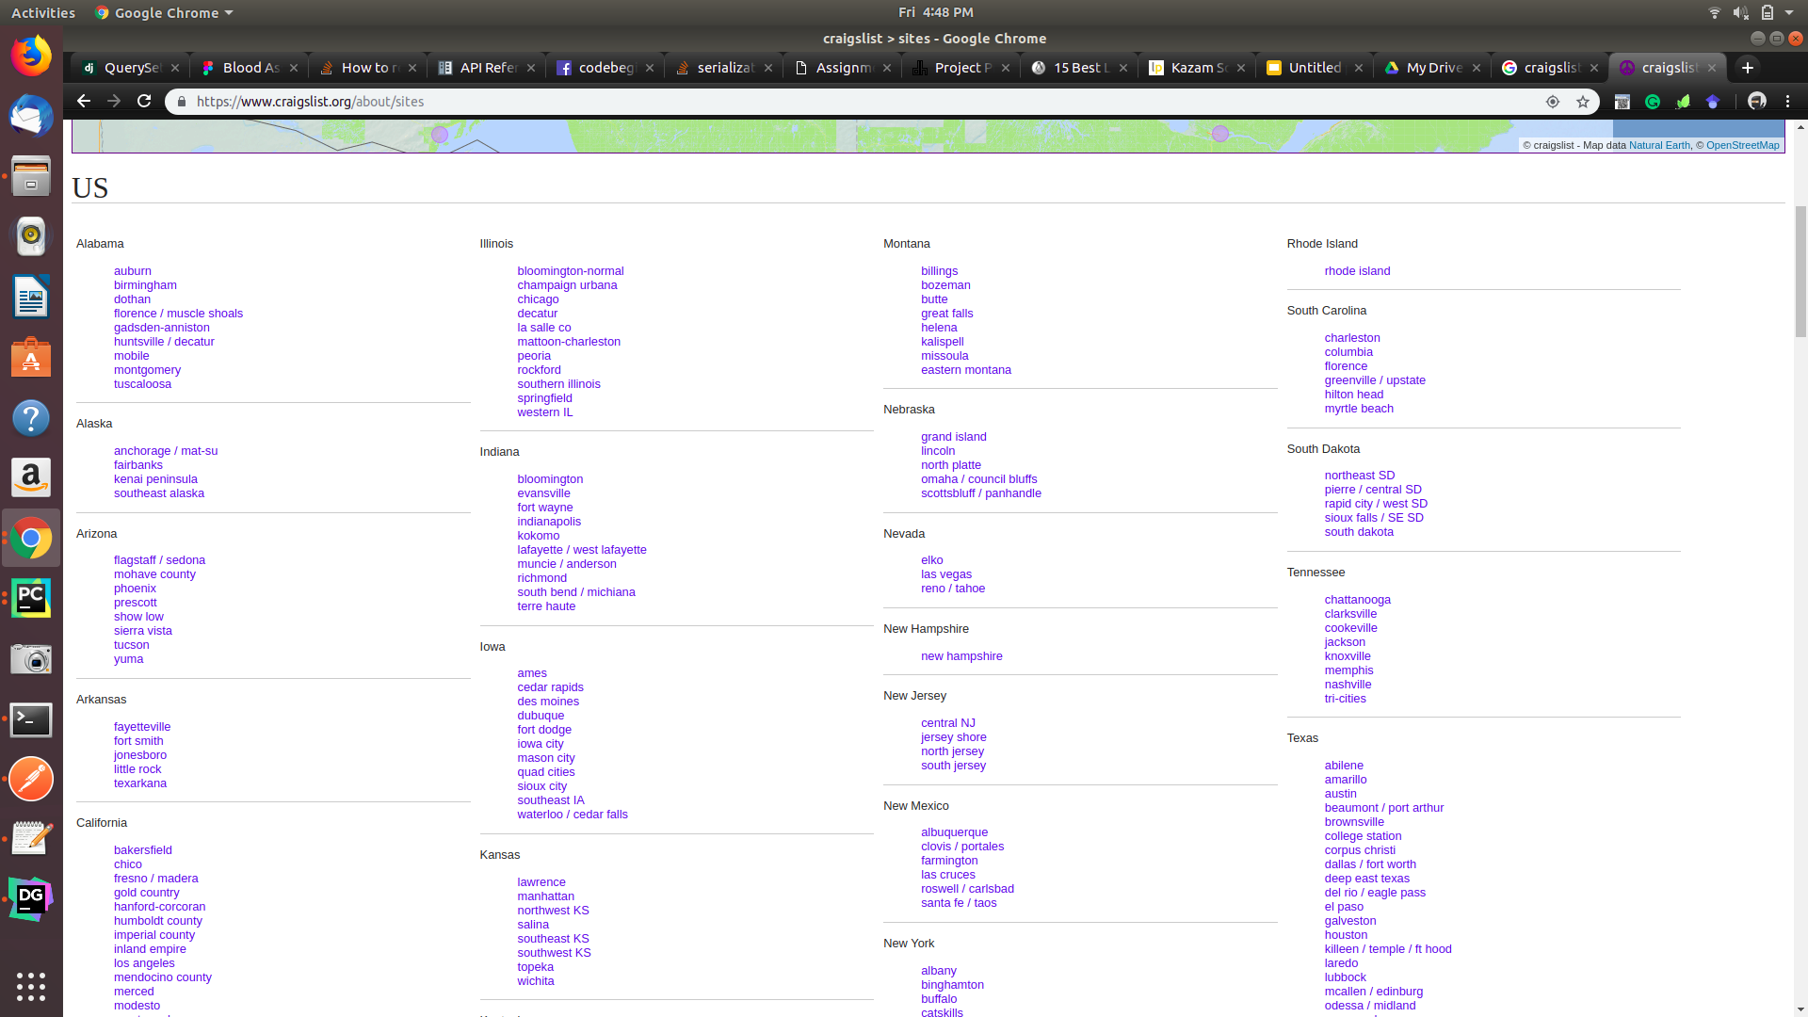

Slide 6
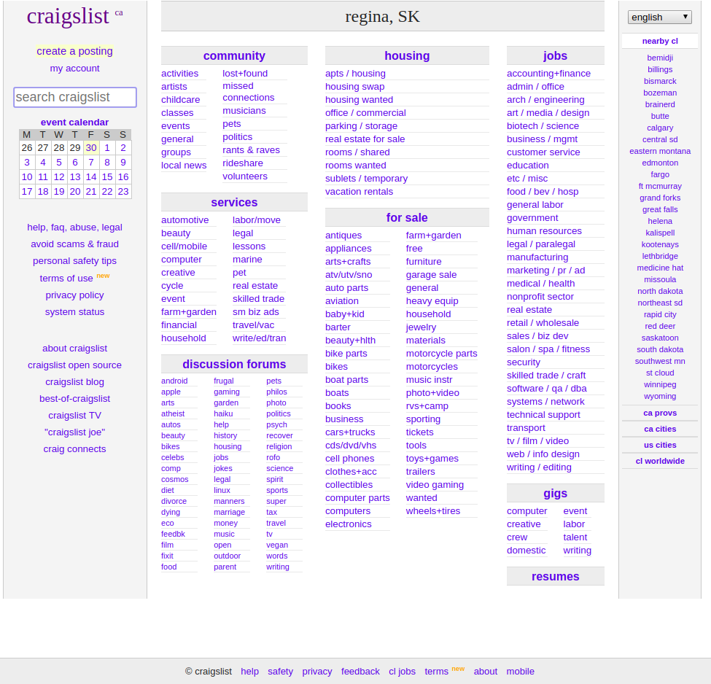

Slide 7
Opportunities to redesign
→ Poor Standards:
Though the website serves more than 30 million page views a month, it does not comply with certain user interface standards such as:
Inconsistency in behaviour (e.g.:- form to post an advertisement)
Improper use of metaphors (e.g.:- use of delete icon to hide something)
Inconsistency in UI elements (e.g.:- placement of price tag)
Ambiguous location tags (e.g.:- placement of location tag and unnecessary abbreviations of city names)

Slide 8
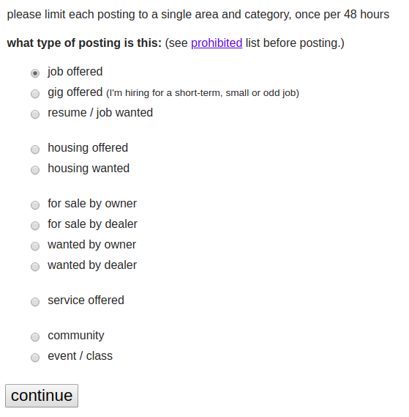
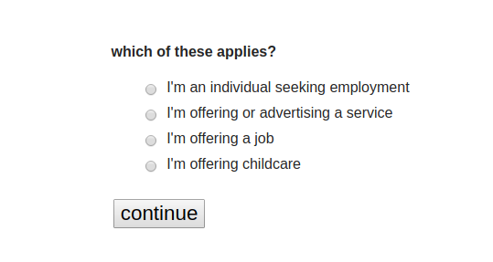
Inconsistent behaviour
The form proceeds even if user has not clicked on “continue” button.

Slide 9


Improper use of metaphors
A delete button is used to narrate “hide” feature.

Slide 10
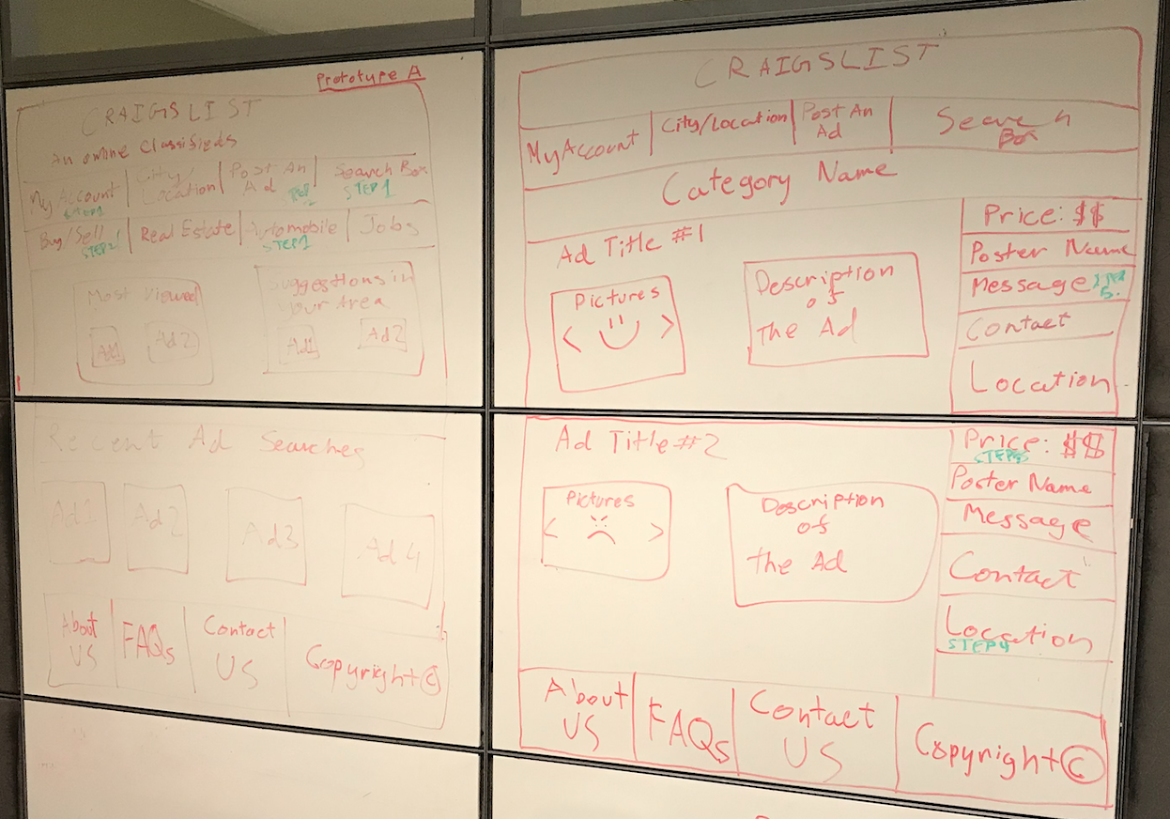
Lo-Fi prototype 1

Slide 11
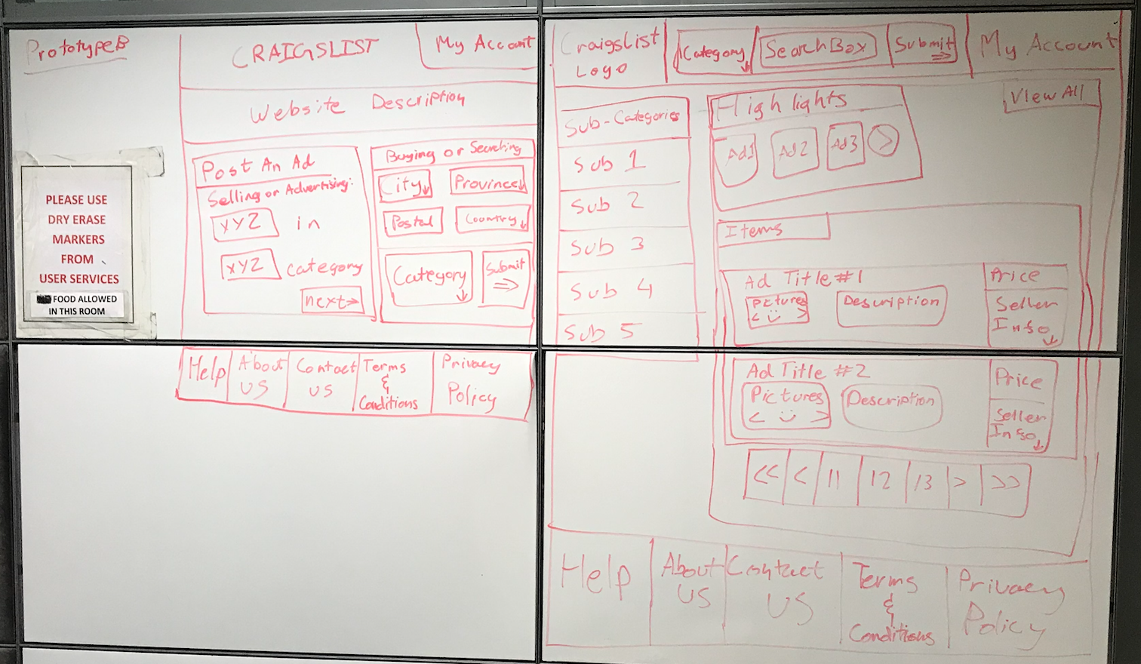
Lo-Fi Prototype 2

Slide 12
Learning Outcomes from Evaluations
Testers prefer the information to be organized and more specified
Testers prefer the search box to be centered
Testers also prefer a static ad page with continuous scroll

Slide 13
Future Plans for Hi-Fi Prototype
The Hi-Fi Prototype would implement a separate ad page which specifies seller/poster contact information
The Search box would be more visible
A continuous scroll system for the ads listing can be considered for implementation

Slide 14
Thank You!

